Slide 1
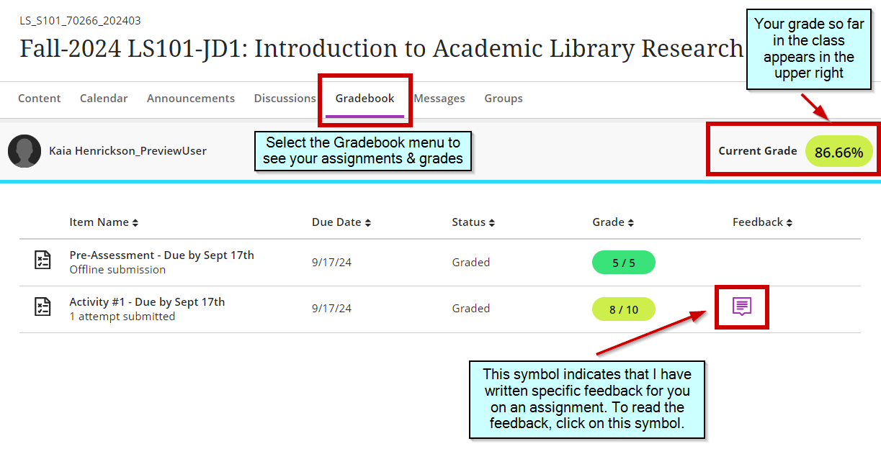
Checking Your Grades

Slide 2
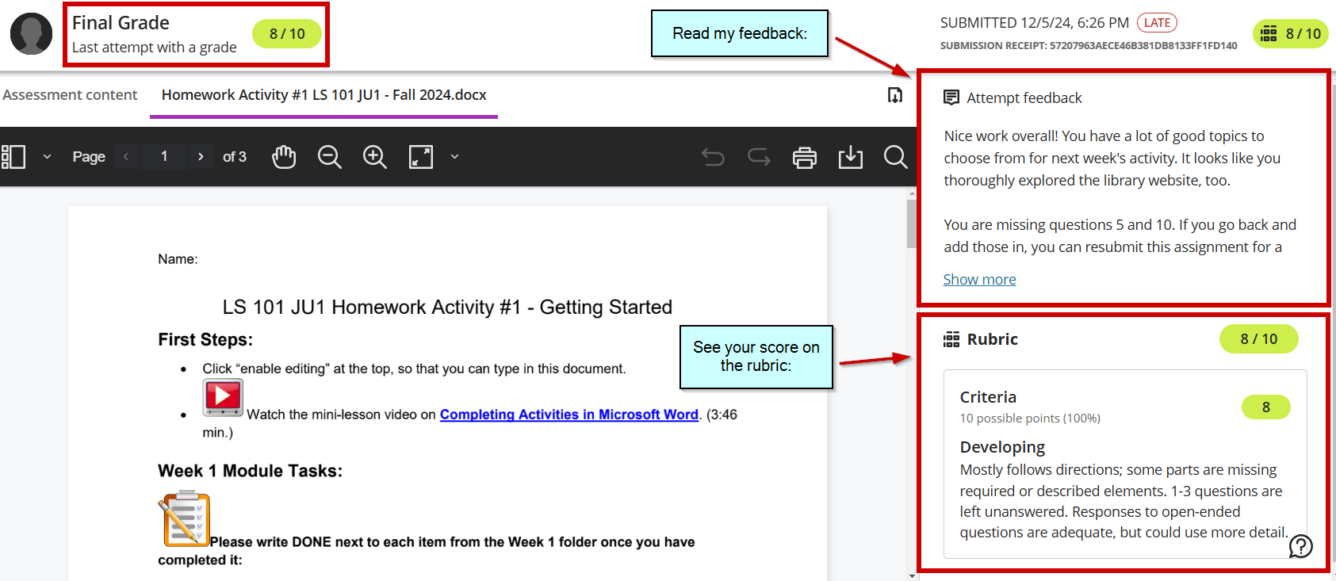
See the Feedback, Access the Rubric & Your Work

